Slide 1





IEEE IC HACK 2.0
TEAM:
VISION EXPLORERS
PROBLEM STATEMENT:
“ADVANCED AUTONOMOUS VEHICLE TECHNOLOGY”
A system that excels in understanding the road and making swift decisions to ensure passenger safety.

Slide 2




OUR TEAM
Yuvraj Yash Grag
Anshika Tiwari
Priyanshu Srivastava
Sahil Keshri
(Team Lead)
Member
IEEE SB RKGIT
UP SECTION
Secretory
IEEE SB RKGIT
UP SECTION
AI Engineer
Final Year CSE- AIML
RKGIT
Robitics Engineer
Final Year CSE - AIML
RKGIT

Slide 3







TABLE CONTENT
Problem Statement
Idea Overview
Market Prospectus
Technical Overview
Execution
Future Scope

Slide 4

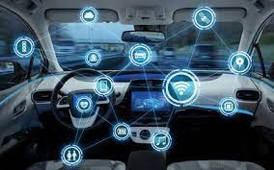
Our Vision
“Our mission is to Our vision is to create a world where road accidents are significantly reduced, if not eliminated, by leveraging autonomous driving technology to enhance vehicle safety.

Slide 5


PROBLEM STATEMENT
Develop a more intelligent system for self-driving cars to ensure passenger safety. The aim is to develop a system that possesses excellent road comprehension and quickly makes decisions to guarantee passenger safety.
Rapid Environmental Understanding
Object Detection and Recognition
Safe Decision-Making
Sensor Fusion

Slide 6
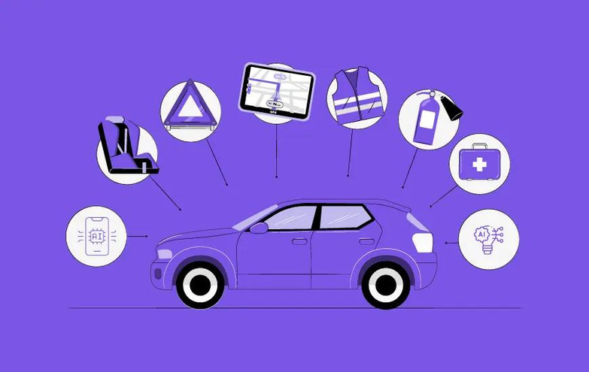
IDEA
OVERVIEW
Autonomous vehicles (AVs) rely on a combination of sensors and software to detect and navigate the surrounding environment, without any human intervention. Cutting-edge sensor technologies are constantly evolving to make autonomous transportation safer for both pedestrians and riders. This has motivated researchers and engineers from a variety of fields and backgrounds to work towards achieving this goal.

Slide 7
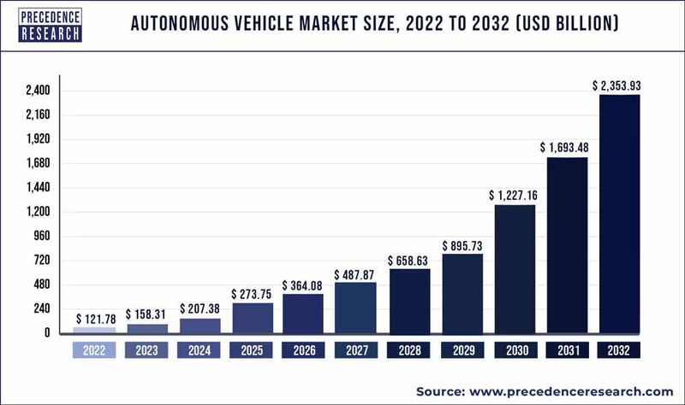
MARKET PROSPECTUS
The market is experiencing a boost in growth due to the rise of the Internet of Things (IoT), machine learning (ML), and artificial intelligence (AI) technologies.The installation of smart traffic lights and connected infrastructure in toll booths and car parks is helping to reduce traffic congestion, further driving the market forward.

Slide 8


TECHNICAL OVERVIEW
A* Search Algorithm
AMCL
Algorithm
SLAM
Algorith
Kalman
Filter
Depth
Camera
LiDAR
Sensor

Slide 9

A 4-wheel grower is equipped with a LiDAR sensor that maps out its surroundings and detects any potential blockages in its path. LiDAR sensors emit invisible laser lights to scan and detect objects in the near or far vicinity, creating a 2D map of the objects and surroundings on the display screen.
LiDAR SENSOR
The depth-sensing camera uses a laser/LED light source to project light patterns, typically
stripes, onto an object to determine its distance.
DEPTH CAMERA
TECHNOLOGY
KALMAN FILTER
it uses data from past time to estimate current and future states. it takes all the data and refine it to find the best solution.

Slide 10
A* Search Algorithm
A* Search algorithm is one of the best and popular technique used in path-finding and graph traversals.
AMCL is a probabilistic algorithm that utilizes a particle filter to estimate a robot's 2D position and orientation based on sensor data. The algorithm operates by representing the robot's position and orientation as a probability distribution of particles. Each particle represents a possible position and orientation of the robot.
AMCL
Algorithm
TECHNOLOGY
method used for autonomous vehicles that lets you build a map and localize your vehicle in that map at the same time.tive.
SLAM
Algorith

Slide 11
SOLUTIONS
Sensing and Perception
Localization and
Mapping
Redundancy and
Safety
AVs need to understand their environment to operate safely. This involves the use of sensors such as LiDAR, radar, cameras, ultrasonic sensors, and GPS to perceive the vehicle's surroundings, detect obstacles, and understand the road layout.
AVs must determine their precise location and create a map of their environment. This is achieved through technologies like high-definition maps, simultaneous localization and mapping (SLAM), and dead reckoning.
Ensuring the safety and reliability of AVs is critical. This involves designing systems with redundancy and fail-safes to handle unexpected situations and system failures.

Slide 12
INNOVATION
Ethical Decision-Making: After classifying the objects, the system needs to make decisions based on their importance. This is a complex and controversial area of research, as it involves making trade-offs between different ethical considerations.
Define a set of rules that prioritize certain types of objects over others. For example, the system might be programmed to always prioritize human life over animal life.

Slide 13
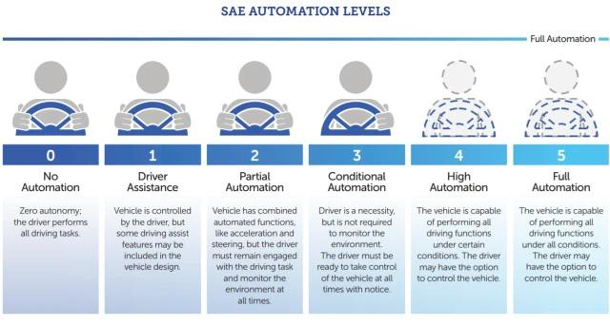
INNOVATION

Slide 14
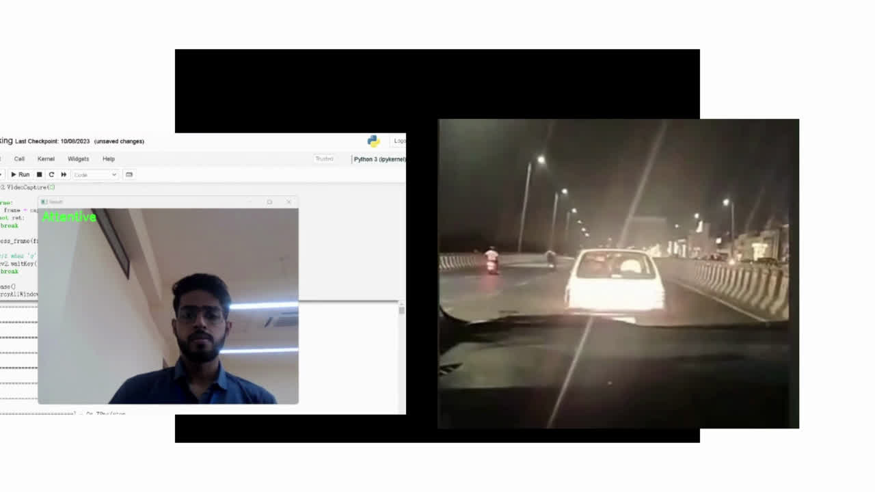
INNOVATION

Slide 15
INNOVATION
The combination of human drivers' practical judgment and ethical reasoning, together with the prowess of artificial intelligence in data analysis and real-time decision-making, is all set to revolutionize Advanced Driver Assistance Systems (ADAS) and self-driving vehicles. In scenarios where human drivers attempt decisions that could potentially lead to perilous outcomes, particularly in moments of driver inattention, the integration of AI within autonomous vehicles assumes a pivotal role.

Slide 16
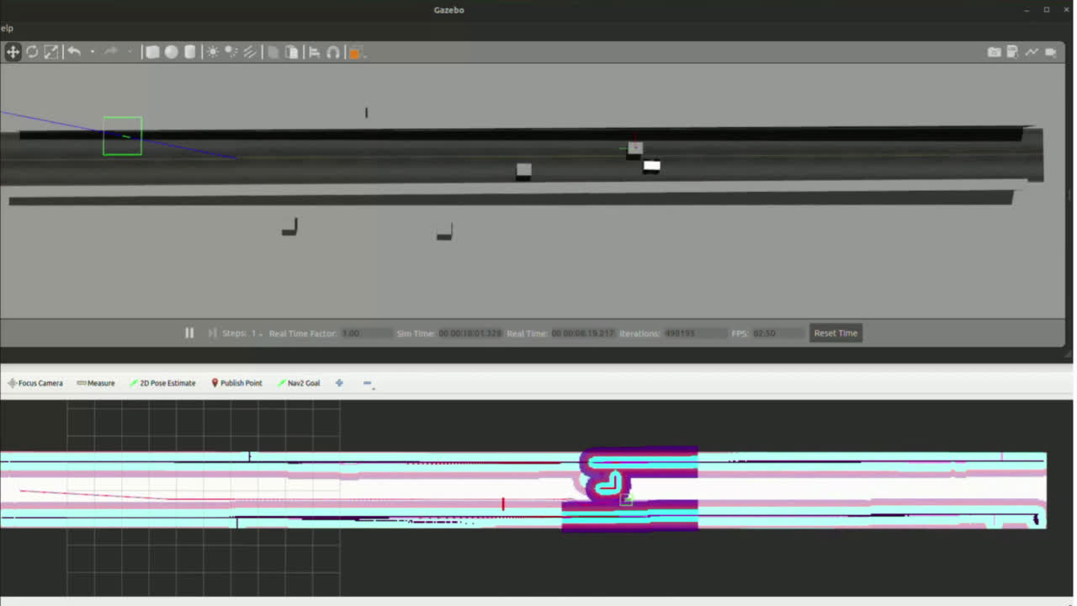

Slide 17
FUTURE SCOPE
V2V and V2I Communication for Cooperative Driving: Vehicle-to-vehicle (V2V) and vehicle-to-infrastructure (V2I) communication can enable cooperative driving, where cars share information and coordinate with each other. This can improve traffic flow, reduce congestion, and enhance safety.
V2V communication messages have a range of over 300 meters, making it possible to detect hazards that may be obscured by traffic, weather, or terrain. V2V communication improves the currently available collision avoidance systems that use radars and cameras to detect potential collisions.

Slide 18
THANK YOU
TEAM VISION EXPLORERS SIGNING OFF!

